Slide 1
Amplifier Characteristics 1 dB Compression Point
Ideal Response
1 dB
Compression Region
Power Output
[dBm]
P1dB
Actual Response
Linear Region
Power Input
[dBm]

Slide 2
Simplest approximation
Ideal Response
1 dB
Compression Region
Power Output
[dBm]
P1dB
Actual Response
Linear Region

Slide 3
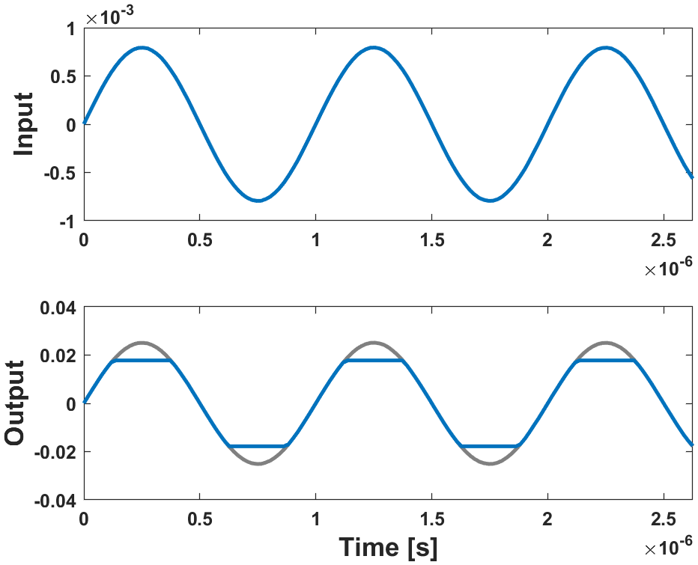
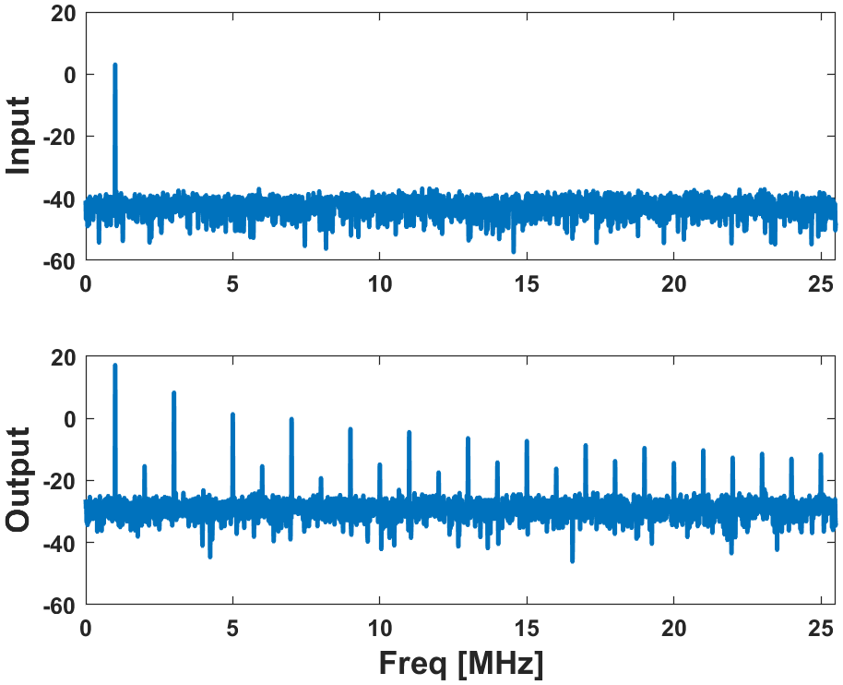
Simplest Approximation
Ideal amplifier

